Slide 1



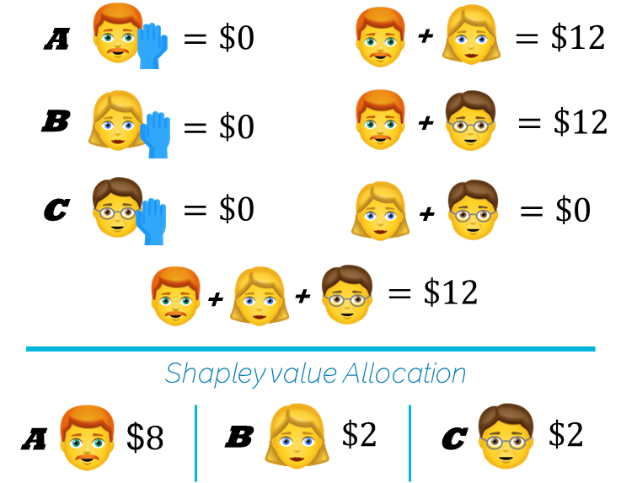
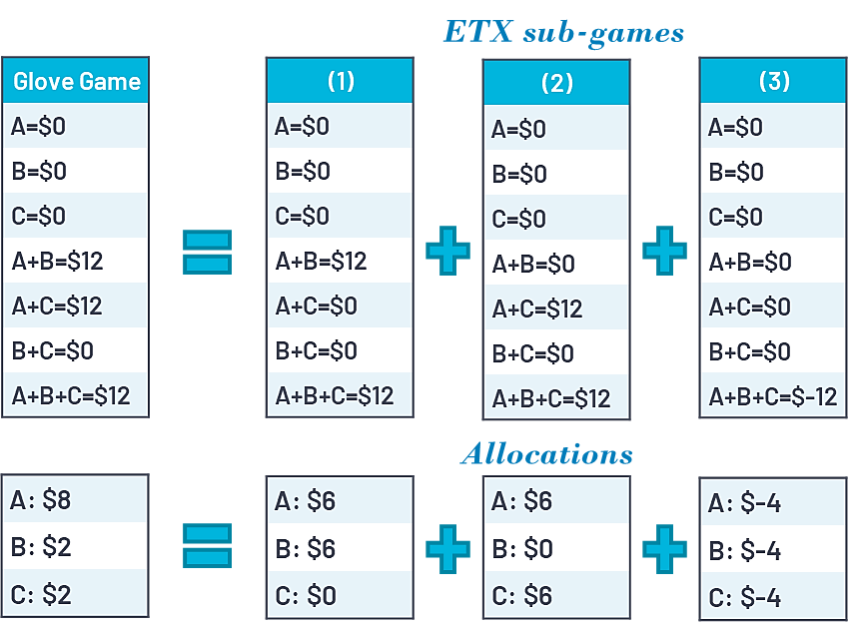
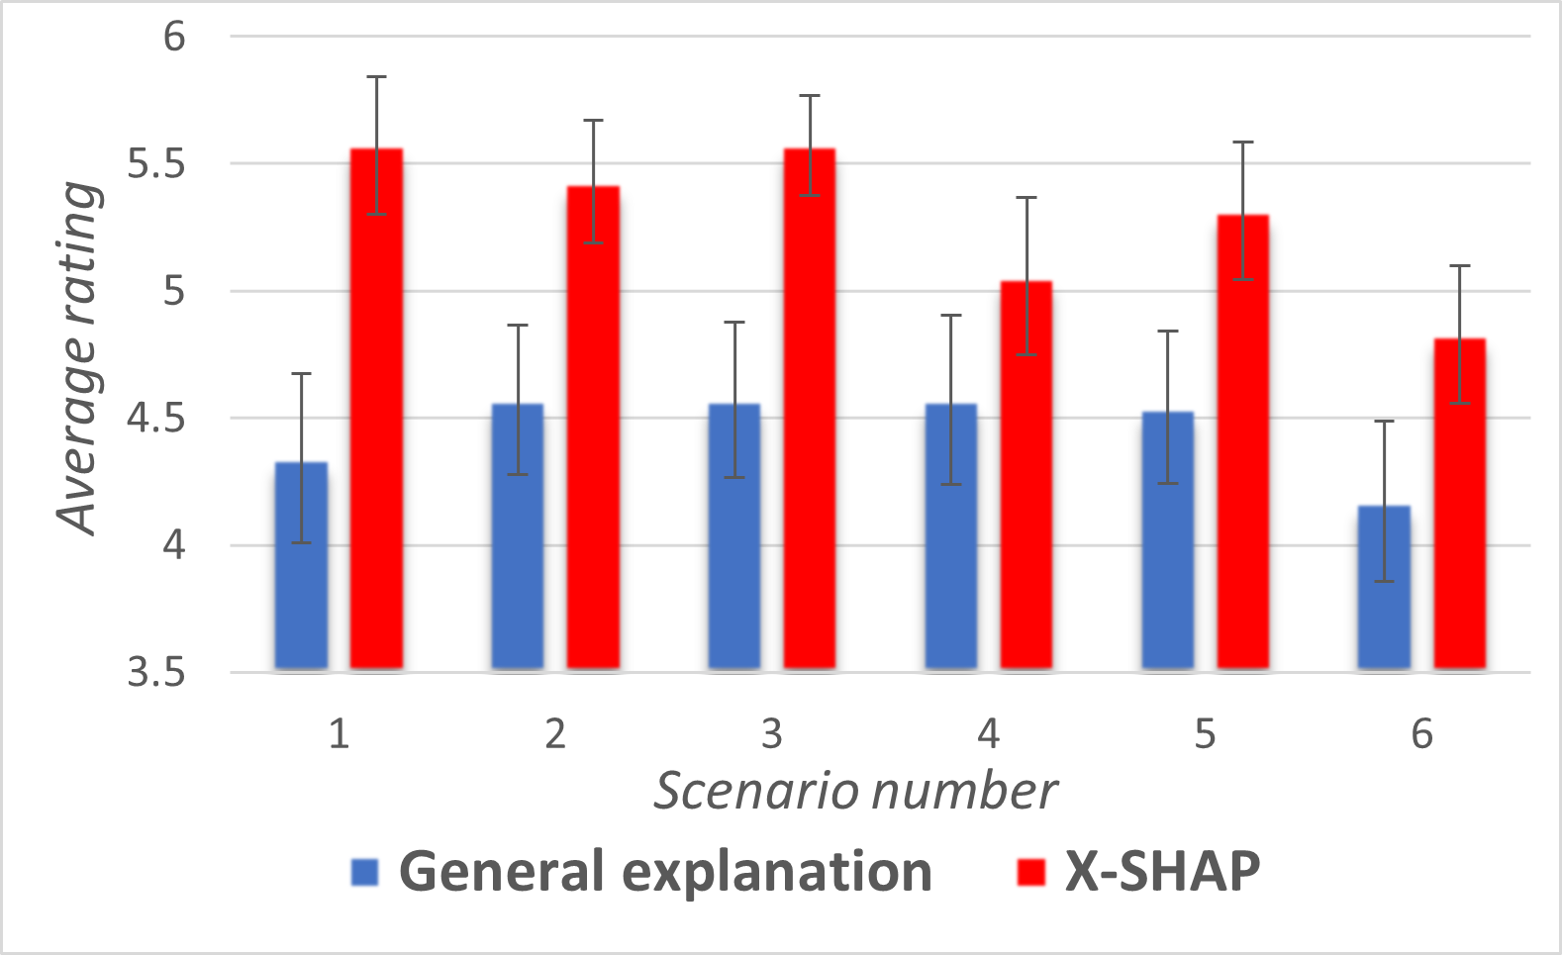
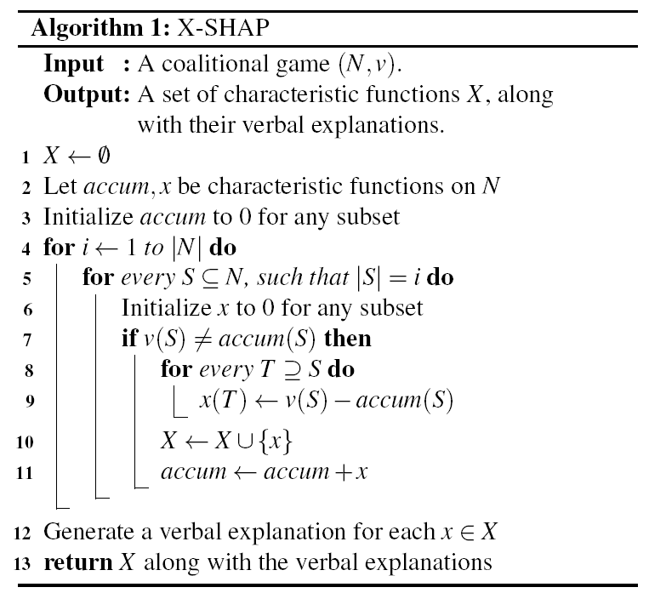
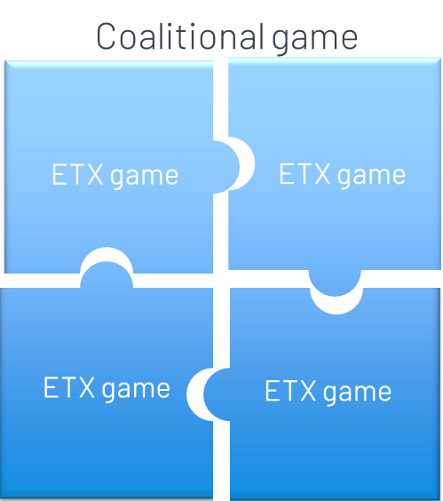
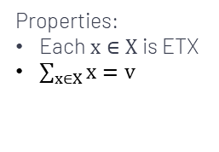
Explainable Shapley-Based Allocation
Meir Nizri, Noam Hazon, Amos Azaria
Department of Computer Science, Ariel University, Israel
Goal is
Simulation: Glove Game
Experiment Results
Problem: humans not always observe the Shapley-value as fair.
Goal: generate intuitive customized explanations for the Shapley-value.
Every game can be decomposed into sequence of sub-games that their Shapley allocation is easier to perceive as fair.
6 scenarios
210 participants
X-SHAP: 5.3
General Explanation: 4.4
Properties:
Each $x∈X$ is ETX
$\sum_{x∈X}{x=v}$

